Slide 1
AMG+: Extended Multilevel Principles Illustrated on the 1D Helmholtz Equation
Achi Brandt
Oren Livne
James Brannick
Karsten Kahl
The Multigrid Round Table
January 7, 2022

Slide 2
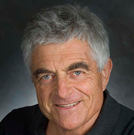
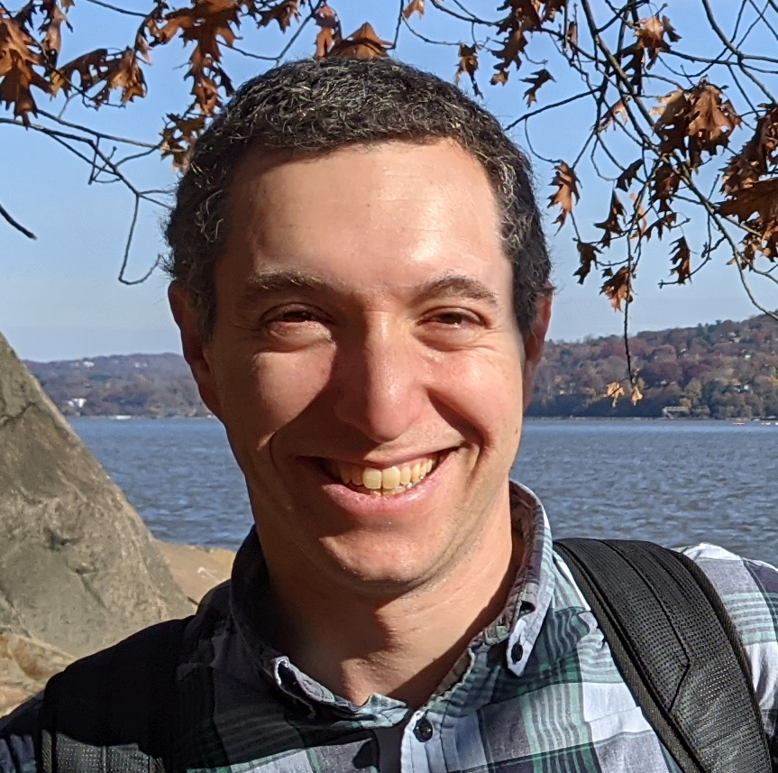
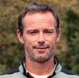
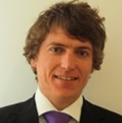
Team
Achi Brandt ACHIBR@GMAIL.COM
Weizmann Institute of Science
UCLA
Oren Livne OREN.LIVNE@GMAIL.COM
Educational Testing Service
James Brannick jjb23@psu.edu
PSU
Karsten Kahl kkahl@uni-wuppertal.de
University of Wuppertal

Slide 3
MOTIVATION
Make AMG work for many new problems

Slide 4
Principle (n.). a general scientific theorem or law that has numerous special applications across a wide field.
Notes:
We want to develop AMG to new specific problems, but in the process formulate generally useful principles that can apply to many new types of problems.

Slide 5
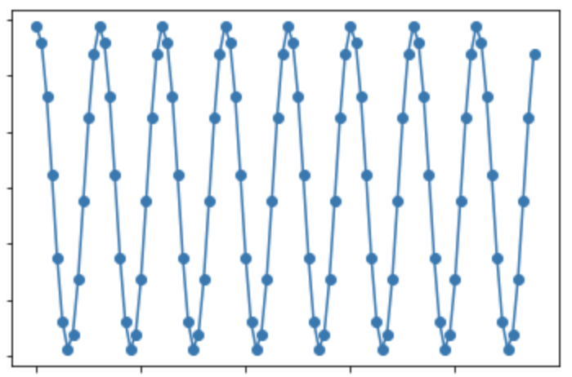



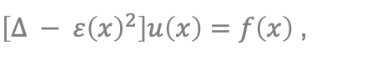






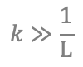

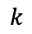
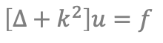







Challenging Problems for AMG
Nearly Singular
Systems
Species are not explicitly identified
Highly indefinite
Emerging types of coarse variables
$$\left|ε\left(x\right)\right|≪\frac{1}{\text{L}}$$
$\left[∆ − ε{\left(x\right)}^{2}\right]u\left(x\right)=f\left(x\right)$,
$$V$$
$$V$$
Stokes
$$U$$
$$P$$
$$U$$
$$P$$
$$U$$
$$V$$
$$V$$
$$U$$
$$P$$
$$U$$
$$P$$
$$U$$
$$V$$
$$V$$
$$\left[∆+k^{2}\right]u=f$$
$$k≫\frac{1}{\text{L}}$$
Multiple types: directional rays
$$k$$
5

Slide 6
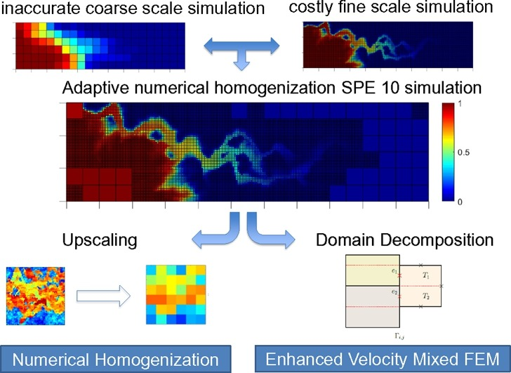
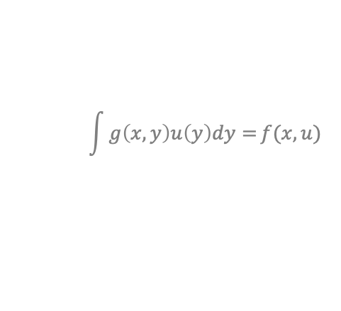
Challenging Problems for AMG (Cont.)
Upscaling
Deriving equations at increasingly coarser scale
Creating interpretable coarse-level variables
Non-linear systems
where a coarse version is not given
Inverse Problems
Non-local equations
Stochastic Optimization
No geometric locations
No locality graph
$$\int{g\left(x,y\right)u\left(y\right)dy=}f(x,u)$$
Neural networks
6
Notes:
This work was inspired by work on challenges in neural networks, which include the last 3 items in this list. (and more)

Slide 7
Goals
SOLVE THE 1D HELMHOLTZ EQUATION
Key challenge: automatically derive ray coarse variables from wave fine variables.
Don’t exploit particulars of Helmholtz or 1D.
Factor out other, unrelated difficulties.
DEVELOP GENERAL MULTILEVEL PRINCIPLES
that can apply to a wide variety of problems.

Slide 8

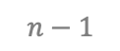


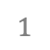
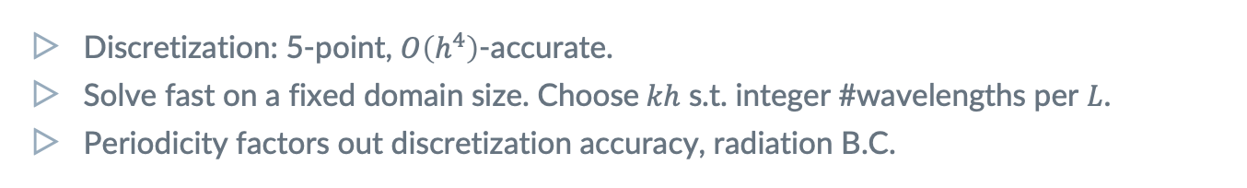

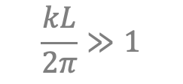


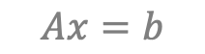



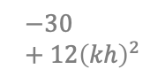
Model Problem: 1D Helmholtz
$$\frac{kL}{2π}≫1$$
$$\left[∆+k^{2}\right]u(x)=f(x)$$
$$x∈[0,L)$$
$$u\left(x+L\right)=u(x)$$
$$0$$
$$1$$
$$…$$
$$n−1$$
$$Ax=b$$
$$−1$$
$$16$$
$$−30+12{\left(kh\right)}^{2}$$
$$16$$
$$−1$$
Discretization: 5-point, $O\left(h^{4}\right)$-accurate.
Solve fast on a fixed domain size. Choose$kh$ s.t. integer #wavelengths per $L$.
Periodicity factors out discretization accuracy, radiation B.C.

Slide 9
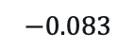
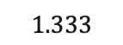
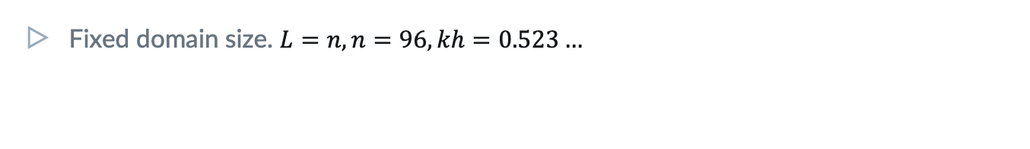
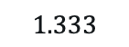
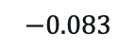
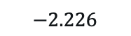
Model Problem: 1D Helmholtz
$$\frac{kL}{2π}≫1$$
$$\left[∆+k^{2}\right]u(x)=f(x)$$
$$x∈[0,L)$$
$$u\left(x+L\right)=u(x)$$
$$0$$
$$1$$
$$…$$
$$n−1$$
$$Ax=b$$
$$−0.083$$
$$1.333$$
$$−2.226$$
$$1.333$$
$$−0.083$$
Fixed domain size. $L=n, n=96, kh=0.523…$
Repetitiveness
We exploit the equations’ repetitiveness for simplicity & eyeing upscaling.

Slide 10
1. Relaxation
should exhibit a fast initial residual reduction,
starting from a random initial guess.

Slide 11
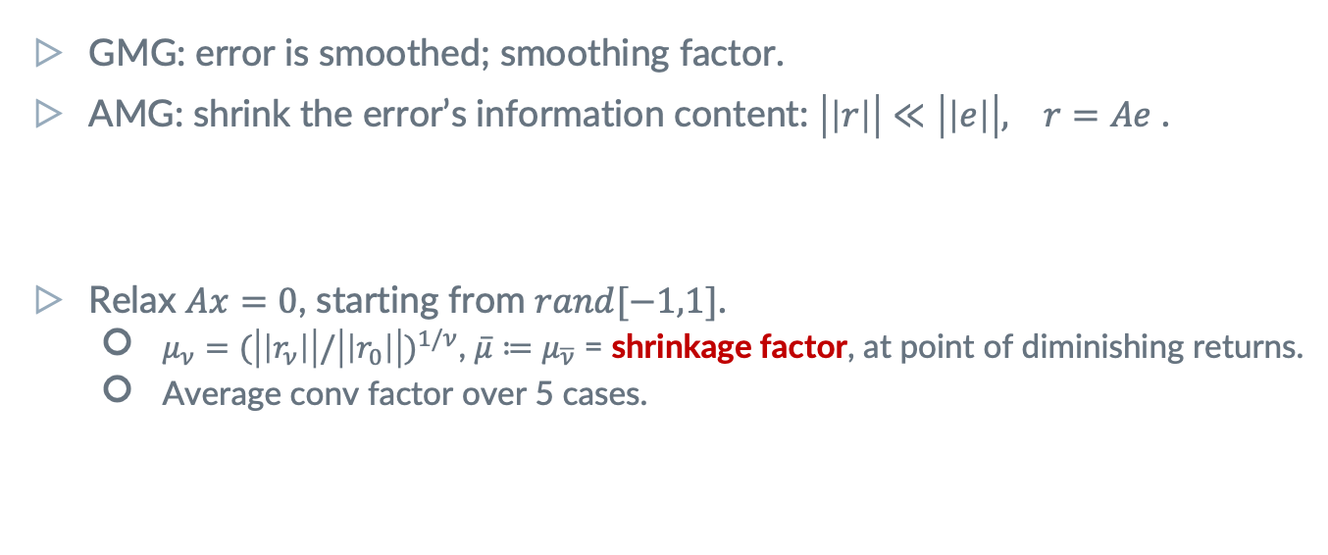
Assessing Relaxation: Shrinkage Factor
GMG: error is smoothed; smoothing factor.
AMG: shrink the error’s information content: $\left|\left|r\right|\right|≪\left|\left|e\right|\right|, r=Ae$ .
Relax $Ax=0$, starting from $rand[−1,1]$.
$μ_{ν}=(\left|\left|r_{ν}\right|\right|/{\left|\left|r_{0}\right|\right|)}^{1/ν}$, $\overline{μ}≔μ_{\overline{ν}}$ = shrinkage factor, at point of diminishing returns.
Average conv factor over 5 cases.
Appropriate norm
is required for distributive relaxation.
Use symmetry!
For a symmetric problem, prefer a symmetric relaxation scheme.

Slide 12
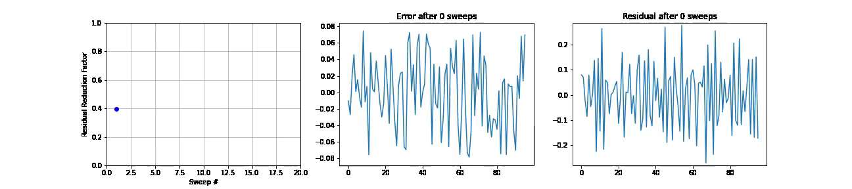
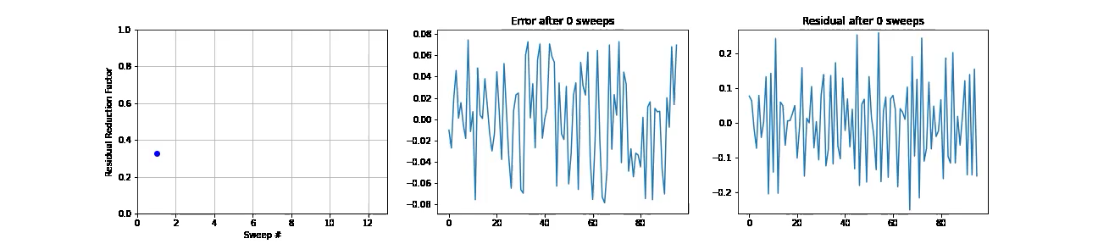
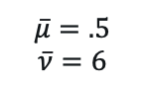
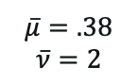
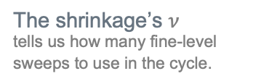
Shrinkage Factor In Action
The shrinkage’s $ν$
tells us how many fine-level sweeps to use in the cycle.
Laplace
GS
$$\overline{μ}=.5$$
$$\overline{ν}=6$$
Helmholtz
Kaczmarz
$$\overline{μ}=.38$$
$$\overline{ν}=2$$
12

Slide 13
2. Test Functions
are examples of slowly-converging errors,
which reveal connection strength between variables.

Slide 14
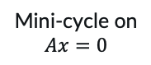
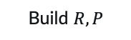
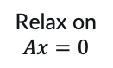
Test Functions (TFs)
Examples of slowly converging errors.
Finding Neighborhoods
Neighbors are highly correlated across TFs.
May be very different from strong coupling.
Bootstrap
Improve TFs while adding levels.
In non-linear systems,
can still produce such examples.
Separating species of vars
is important in systems.
Near null-space functions
If exist, are eventually revealed as slow-to-converge functions in the cycle.
Build $R, P$
Cycle
TFs
Relax on $Ax=0$
Random starts
Mini-cycle on $Ax=0$
Notes:
Examples can be constructed also in non-linear systems.

Slide 15
3. SVD Coarsening
reveals the right type of coarse variables, and guides the choice of coarsening ratio.

Slide 16
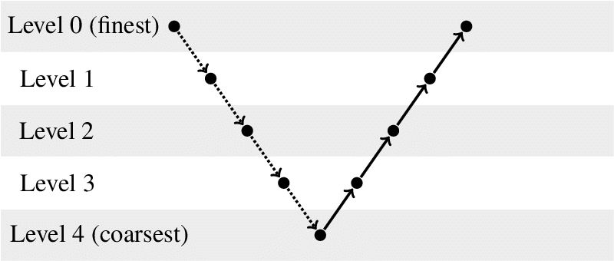
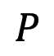
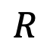
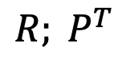
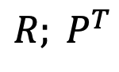
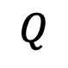
Quick Notation
Coarsening: the definition of coarse variables.
Interpolation: transfer coarse vector to fine level.
Restriction: transfer fine vector to coarse level.
For instance,
$${R; P}^{T}$$
$$R$$
$$P$$
$$Q$$
For instance,
$${R; P}^{T}$$

Slide 17
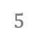
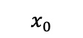
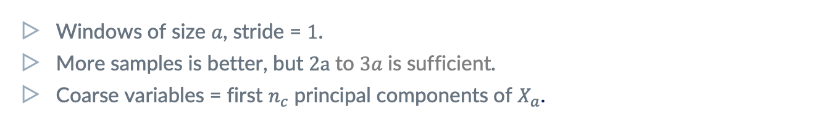

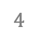
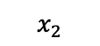
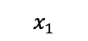

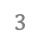
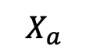
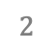
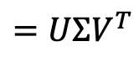


Sample Windows from single TF
$$X_{a}$$
$$=UΣV^{T}$$
$$a$$
$$x_{0}$$
$$x_{1}$$
$$s$$
$$x_{2}$$
$$…$$
$$0$$
$$1$$
$$2$$
$$3$$
$$4$$
$$5$$
$$…$$
$$n−1$$
Non-repetitive case:
Generate multiple TFs.
Windows of size $a$, stride = $1$.
More samples is better, but $2a$ to $3a$is sufficient.
Coarse variables = first $n_{c}$ principal components of $X_{a}$.
Multiple coarse vars per aggregate.
AMG+ may use more than one coarse var. Related to SA.
Notes:
Principal components = first n_c columns of V.

Slide 18
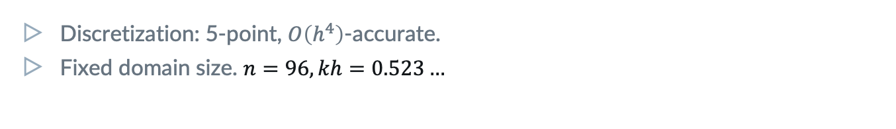
SVD Coarsening in Action
$$0$$
$$1$$
$$n−1$$
$$−0.083$$
$$1.333$$
$$−2.226$$
$$1.333$$
$$−0.083$$
Discretization: 5-point, $O\left(h^{4}\right)$-accurate.
Fixed domain size. $n=96, kh=0.523…$
Repetitiveness
We exploit the equations’ repetitiveness for simplicity & eyeing upscaling.

Slide 19
4. Quantitative Quality Prediction
allows designing each multilevel component separately and reliably (coarsening & cycle).

Slide 20
5. Interpolation
is constructed to accurately reproduce TFs, but tested via two-level cycle rates.

Slide 21
6. Bootstrap
Improves and reveals test functions as more levels are gradually added to the multilevel solver.

Slide 22
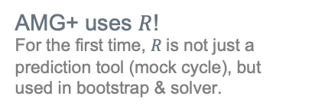
Coarse-level Equations
Temporarily Work with expensive, accurate operator for 2-level bootstrapping
Post-processing
Sparsify
Symmetrize
AMG+ uses $R$!
For the first time, $R$is not just a prediction tool (mock cycle), but used in bootstrap & solver.

Slide 23
7. Coarse-level Construction is Local,
which is especially useful for repetitive problems & upscaling.

Slide 24


Coarse-level Construction is Local (In Principle)
Relaxation is local, so producing TFs is local.
In repetitive problems, sample across the domain.
Mock cycle rate well estimated on domain size = $4 × \text{aggregate}\text{_}\text{size}$.
Two-level cycle rate well estimated on domain size = $4 × \text{aggregate}\text{_}\text{size}$.
Exploit repetitiveness!
Sample across the (local) domain.
Tile $R, P$ of a single aggregate.
In graph problems,
define domain as a graph neighborhood of a node.
Notes:
Examples can be constructed also in non-linear systems.

Slide 25
Systematic Upscaling (WIP)

Slide 26

Recap of AMG+ Principles
Relaxation should have good shrinkage.
Test Functions (TFs) are used to construct coarsening & interpolation and.
Coarse-level variables are obtained by local TF SVD and tested by the mock cycle.
Quantitative quality prediction tools, e.g., the mock cycle, guide the separate design of each multigrid component.
Interpolation is constructed by least-squares fitting of TF values, but ultimately tested via 2-level cycle.
TFs & cycle are iteratively improve each other via bootstrap.
Coarse-level construction is a local process and can naturally support upscaling.

Slide 27
Thanks!
Questions/Ideas for Applications?
Twitter
#AMG+
Email us at
achibr@gmail.com
oren.livne@gmail.com
jjb23@psu.edu
kkahl@uni-wuppertal.de

Slide 28
EXTRA SLIDES

